Slide 1
Glocalizing Climate Governance
(GlocalClim)
Workshop October 29, 2021
Part I Speedtalks

Slide 2
Module 1:
Mapping and explaining global adaptation governance

Slide 3
Work in progress
1. “Explaining the Diffusion of Climate Frames in IOs” (GC collaboration)
2. “Studying Climate Debates on Twitter” (GC collaboration)
3. “Machine-Learning Based Text Classification for Political Scientists: The Case of United Nations Agencies' Communication about Climate Change on Twitter” (GC collaboration)
4. “Explaining Coalition Building on Climate Policies among EU’s Regulatory Agencies” (external collaboration)
Published works (2021)
1. Shyrokykh, K. (2021) "Why climate? The drivers of the European Union’s climate governance in its post-Communist neighbourhood". Problems of Post-Communism, online first.
2. Shyrokykh, K. (2021) "Help your neighbour, help yourself: The drivers of EU’ climate cooperation in trans-governmental networks with its neighbours". Governance, online first.
3. Tosun, J. and Shyrokykh, K. (2021) "Leadership in high-level forums on energy governance: China and Russia compared". Post-Communist Economies, online first.

Slide 4
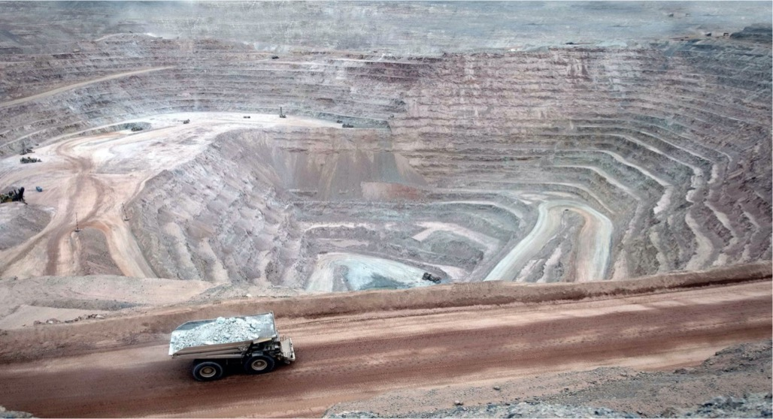
The Moral Foundations of Private Adaptation:
Evidence from the Mining Sector
Book project by Maria-Therese Gustafsson and Lisa Dellmuth
Rationale
3
1
Contribution to knowledge about adaptation and
private governance scholarship
In the private sector, there is a strong focus on climate risks as a technical issue for business resilience, not for societal adaptation
At the same time, there is normative shift in which companies are increasingly held accountability for producing social and environmental harm
We need to gain a better understanding to gain a better understanding about ethical behaviour in private adaptation
Developing a theoretical framework for normative standards for morally justifiable private adaptation, based on theories on private governance, democracy, and business & human rights
Assess the moral qualities of private adaptation responses of the 37 largest mining companies in the world
Draw academic and political attention to transparency, accountability, participation, distributive justice in private adaptation
Research questions
2
4
When is private adaptation morally justifiable?
How, why, and when do private companies adapt to climate risks in morally justifiable ways?
Methods and material
Qualitative and quantitative analysis of corporate documents and semi-structured interviews with company leaders and policy-makers

Slide 5
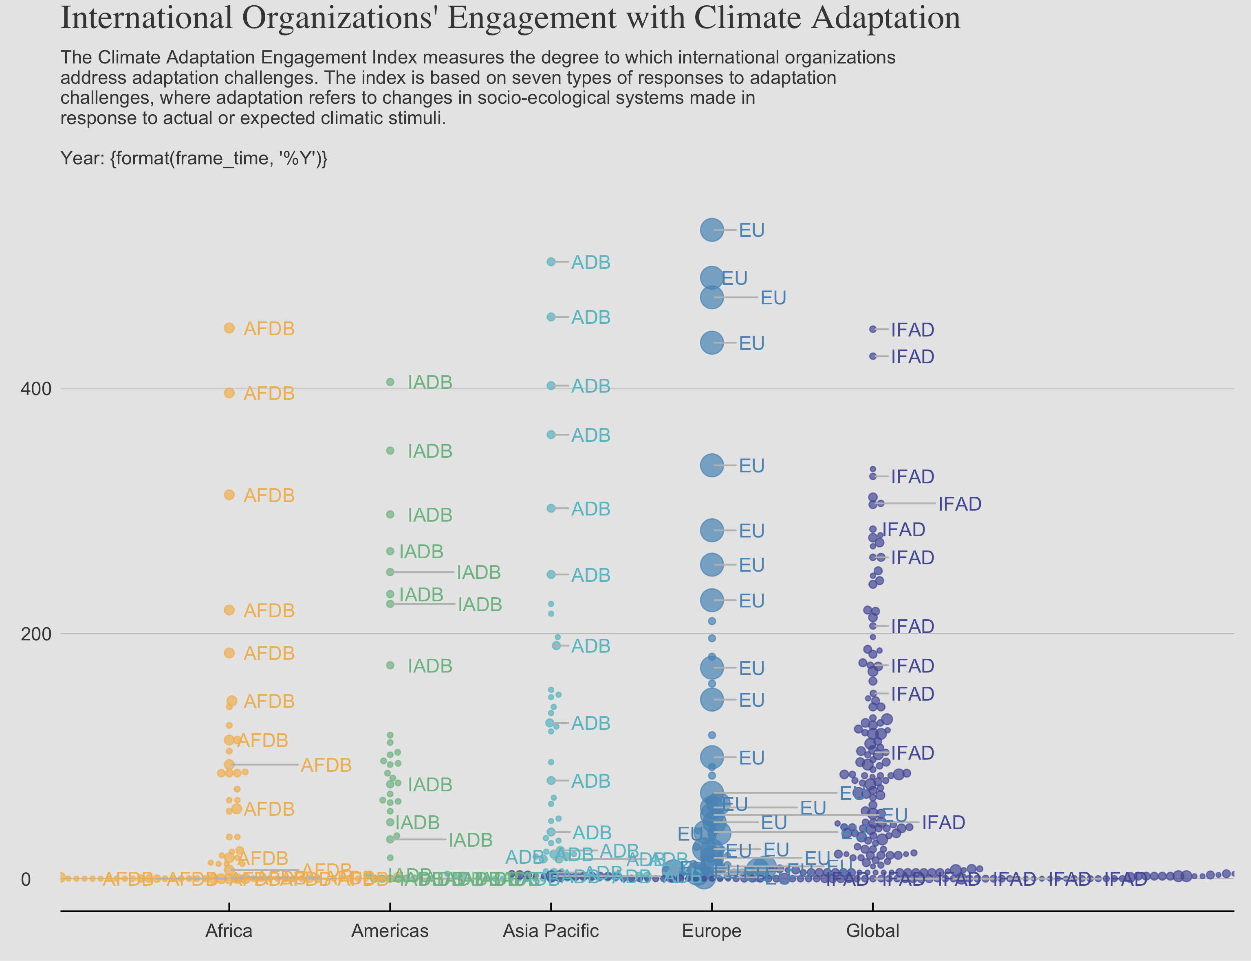
Animated plots in R
Libraries
library(ggplot2)
library(gganimate)
library(geom_repel)
Prepwork
Create ggplot object +
geom_text_repel(aes(label = IOname,
color = factor(region)),
data = CCA_cumsum_top)
Animate
CCA_beeswarm_plot +
transition_time(year)
Source: Kural, Dellmuth, Gustafsson (2020), A New Dataset for the Social Scientific Study of Adaptation, PLoS ONE 16(9): e0257101

Slide 6
Module 2:
Mapping and explaining justice and legitimacy in global adaptation governance

Slide 7

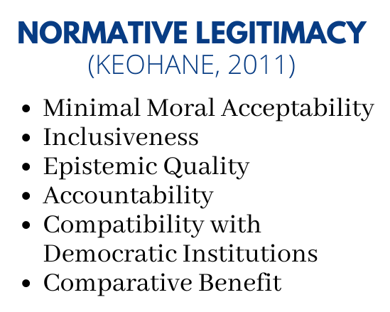
Perceptions of Justice and Legitimacy in the UNFCCC among non-state actors (NSA)
Hypotheses
Legitimacy beliefs toward the UNFCCC are stronger among NSAs believing in the UNFCCC’s environmental justice.
Legitimacy beliefs toward the UNFCCC are stronger among NSAs believing in democracy and effectiveness in the UNFCCC
Research question
What are the sources of NSA legitimacy beliefs toward the UNFCCC?
Gaps
Theoretical: Legitimacy literature has not focused on environmental justice sources.
Empirical: Lack of evidence on NSA justice and legitimacy perceptions, differences therein.
Contribution to IR
Legitimacy research
NSA research
Adaptation governance research
Methods
Large-n survey → nine types of NSAs in the UNFCCC
Article authors: Suanne Segovia, Lisa Dellmuth and Maria-Therese Gustafsson

Slide 8
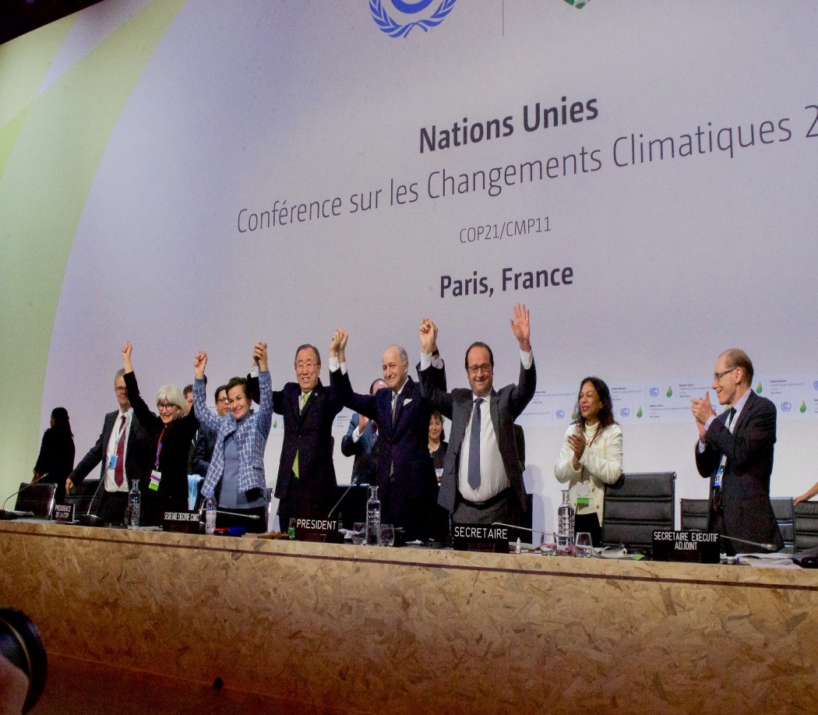
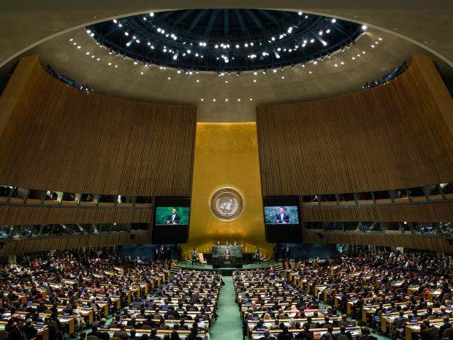
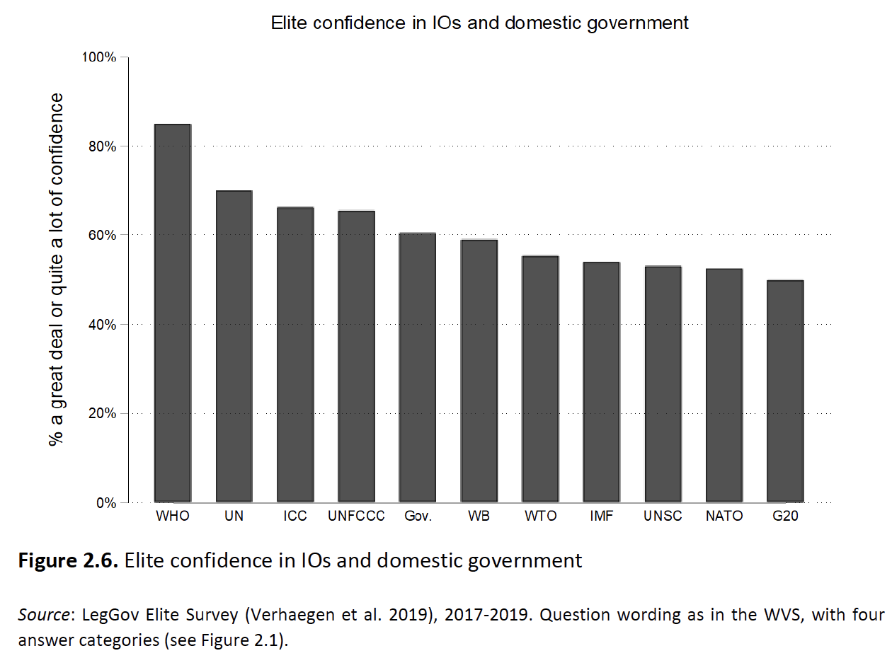
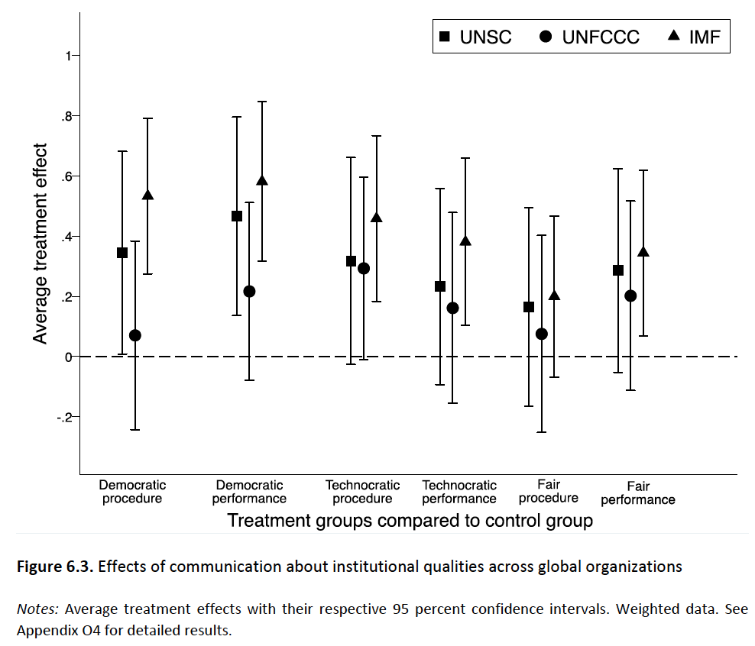

Lisa Dellmuth and Jonas Tallberg, The Legitimacy of International Organizations: How Elites Influence Public Opinion, Cambridge University Press (forthcoming in 2022, 315p.)

Slide 9
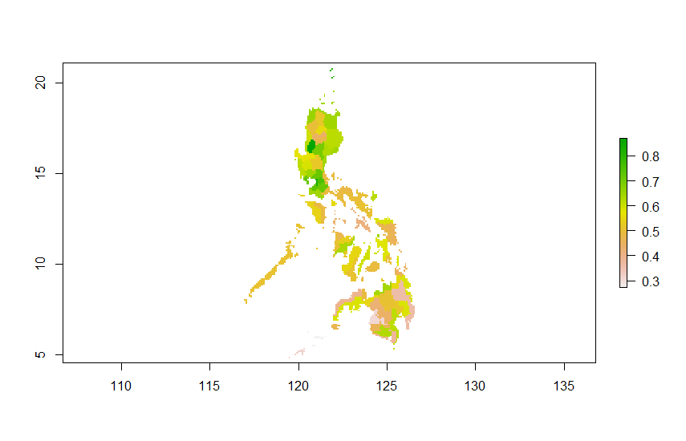
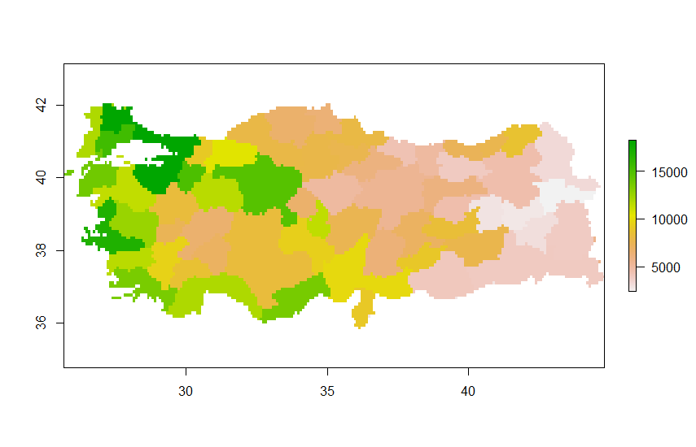
Socio-Economic Subnational Data
HDI: Philippines
GDP PPP per capita: Turkey
Data aggregation
”The data divide”
Trap of averages and data nationalism
Available data
HDI, GDP, population indicators
GIS: Raster data + polygons
Therese Christoffersson
Source: Kummu, M. et al. (2018). Gridded global datasets for Gross Domestic Product and Human Development Index over 1990–2015. Scientific Data, 5.

Slide 10
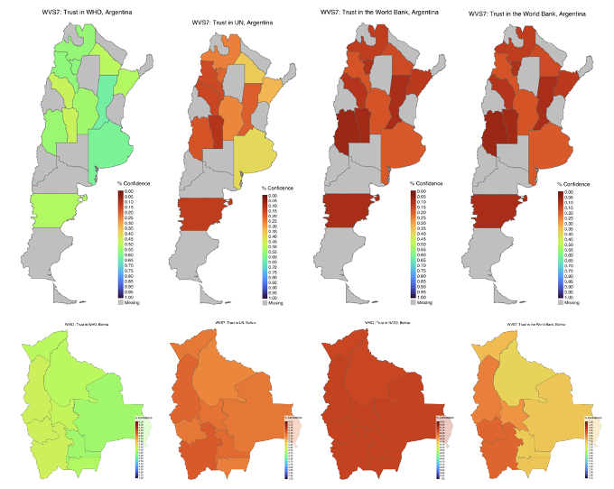
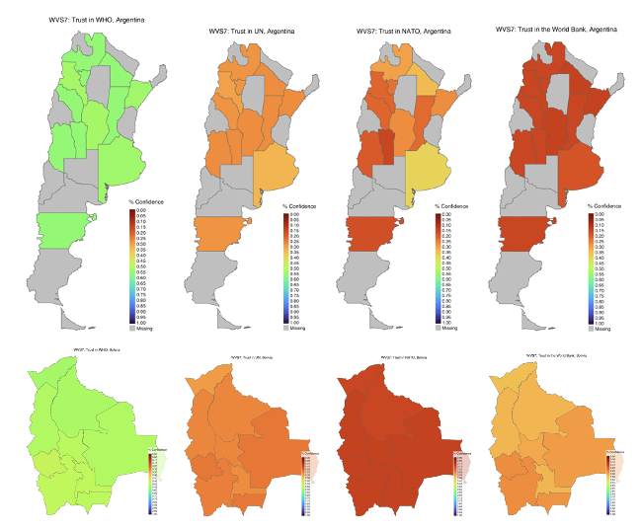
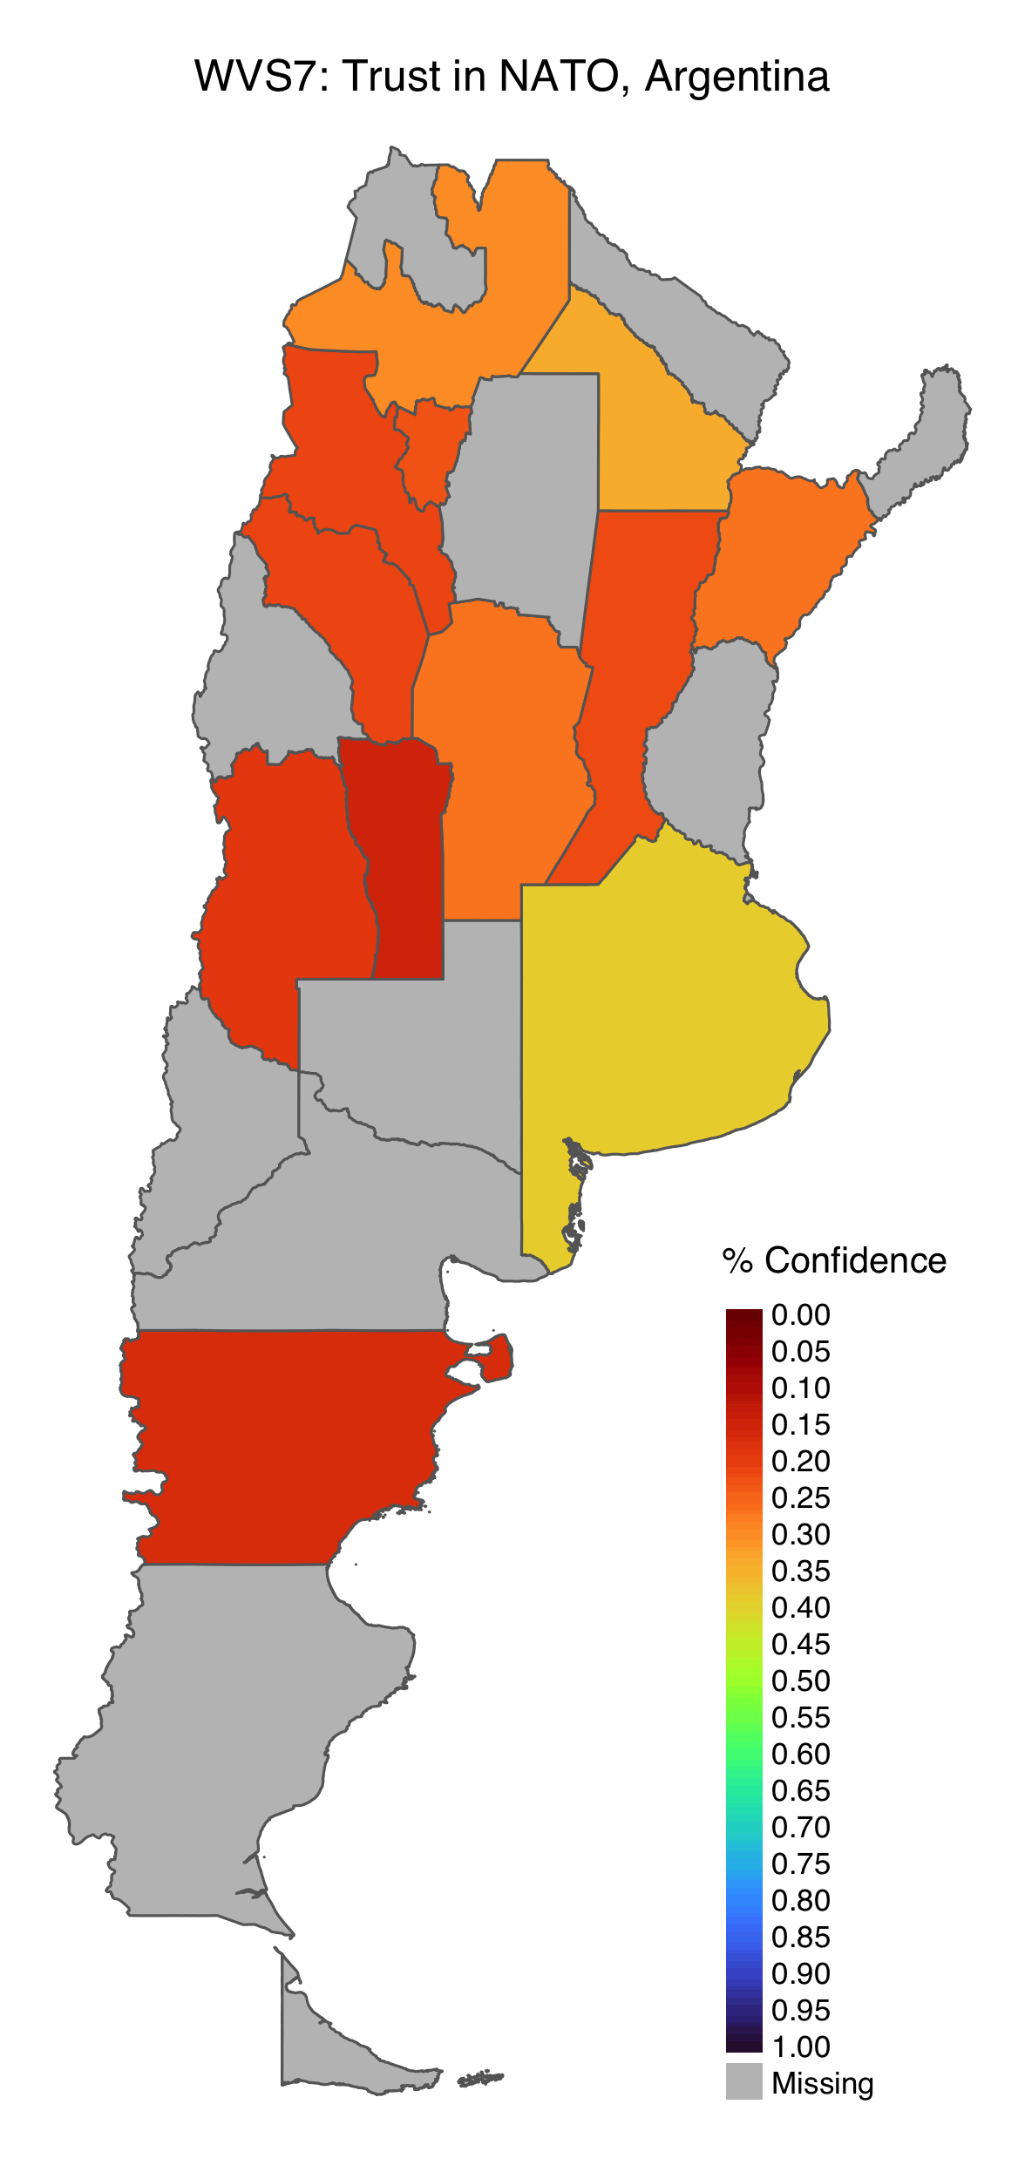
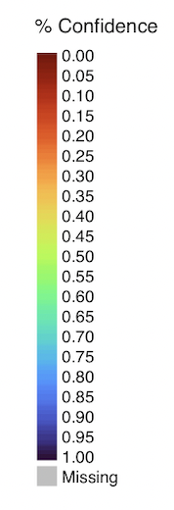
Subnational Legitimacy Beliefs in Climate Organisations
Multilevel regression with synthetic poststratification (MrsP)
Bayesian additive regression tree (BART) with synthetic post-stratification
Method:
WHO
UN
NATO
World Bank
WHO
UN
NATO
World Bank
Argentina
Bolivia
Lisa Dellmuth, Associate Professor
Evelina Jonsson, Research Assistant
Source: World Value Survey (2020); European Value Survey (2018); GADM 2021; National statistics offices; IPUMS International
Project co-funded by Legitmacy in Global Governance (LegGov), Riksbankens Jubileumsfonds from 2016-2021

Slide 11
Module 3:
Explaining glocalization effects on adaptation in the Global South

Slide 12
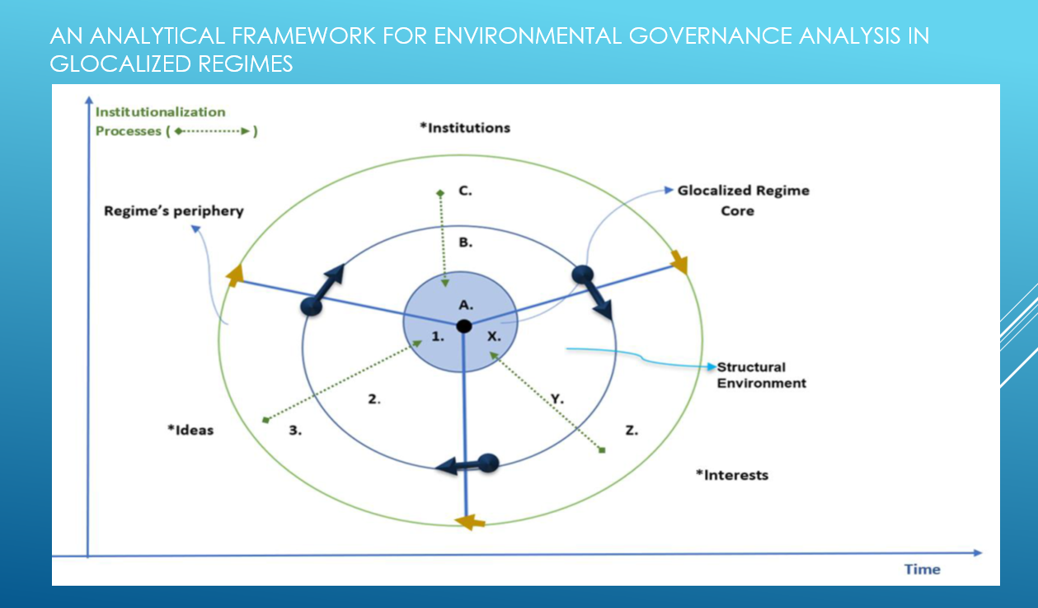

Slide 13
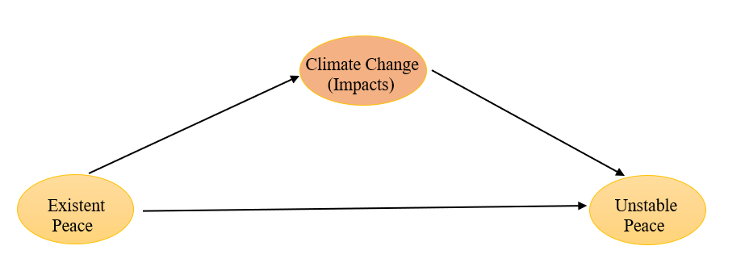
Existent peace can become instable due to various reasons
  Assumption: Climate change (impacts) can affect existent peace becoming instable
  Direct vs indirect effects?
Peace = not just negative peace (absence of war/conflict)

Slide 14
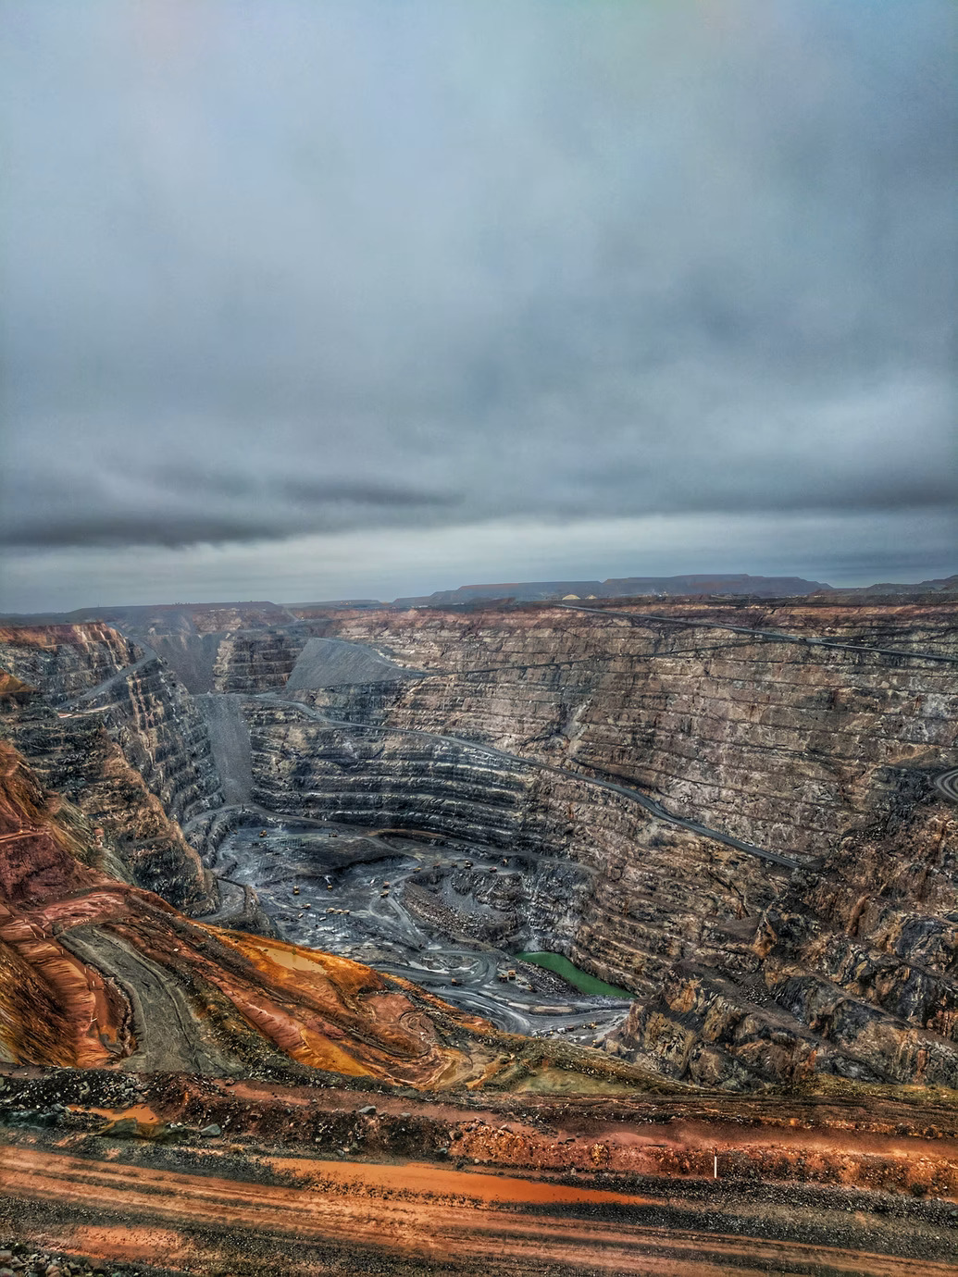



Climate Change and Mining: Lessons for policy-making
Policy report produced for the Environmental Governance program, and data story at the LandPortal
Based on GlocalClim research, these outputs provide practitioners with an overview of the multiple links between mining and climate change and provides for actionable knowledge and policy recommendations for how to improve governance for sustainability.

Slide 15
Glocalizing Climate Governance
(GlocalClim)
Workshop October 29, 2021
Part II Keynote presentation

